Slide 1
Reflex Overview and Architecture
Module 1

Slide 2
Agenda
Typical Big Data Pipeline on Reflex
Introducing Reflex
Reflex Platform Architecture and Components
Base Platform Layer
Reflex Analytics Fabric

Slide 3
Anatomy of Big Data Applications
Analytics
Ingestion
Enrichment
Curation
Views
Output/
Application
Data Bus
Raw
Data
Model
Physical
Data
Model
Logical
Data
Model
Conceptual
Data
Model
Notes:
Physical Data Model (PDM): Unified model for each domain, hides data source or vendor variations within a domain.
Logical Data Model (LDM): Unified model for each Use Case, hides data domain variations and eases Use Case implementation.
Conceptual Data Model (CDM): Model for Business/User specific view of a Use Case

Slide 4
Ingestion
Big data ingestion is about moving data from where it is originated(many), into a system where it can be stored and analysed.
Achieved using:
Extract
Load Distribution
Raw Data Model
Notes:
Ingestion
Ingestion module provides the following functions:
Extract
Act as a centralised interface for external data sources. Pull the data from the data source or listen/receive the data pushed from data source. Provide a highly optimised, minimal processing to split the received blocks of data into individually processable records (deserialise).
Load Distribution
Distribute the received data across multiple nodes in order to enable parallel processing of the received data. This is critical to achieve scalability for subsequent modules.
Complex, Slow and Expensive
Purpose-built and over-engineered tools make big data ingestion complex, time consuming, and expensive
Writing customized scripts, and combining multiple products together to acquire and ingest data can slow you down

Slide 5
Enrichment
Primary purpose of enrichment stage is to
add value to the data content
isolate any input data format variations across vendors, data sources, equipment's etc and present a normalized view of the data to subsequent modules optimized for further processing.
Achieved using:
Distribution/Scale
Join
Filter/transformations
Catalog data processing
Physical Data Model
Notes:
Primary purpose of enrichment module is to
add value to the data content and,
isolate any input data format variations across vendors, data sources, equipments etc and present a unified view of the data to subsequent modules
This is achieved using following functions:
Common Transform
Add/Drop fields from the records. All transforms that are use case agnostic.
Filter
Validation checks, drop corrupted records, drop uninteresting records
Join
Combine information from multiple data streams
Catalog Data Processing
Transform catalog data to a format that can be efficiently stitched with data records
Sessionisation
Stateful processing of input data to identify all the records that belong to a single session.

Slide 6
Curation
Curation is required to
Curate the data as per the use case
Reduce data volume
Achieved using:
Transform
Aggregate
Load
Binning
Logical Data Model
Notes:
Curation module is required to curate the data according to the use case, reduce the data volume and to lay the data out in a format that can be more easily queried. This step is crucial to ensure that reasonable query response times can be achieved.
This is achieved using:
Use Case Transform
Add/Drop fields from the records. All transforms that are specific to a use case.
Aggregation
Use case specific reduction in data volume can be achieved using efficient data structures, probability and statistical techniques like PCSA, Roaring Bitmap, AVS Buffers, K-Means compression, Dense Vector etc
Load
Loading the data to a database. Persisting the data.
Bin Tagging
Labelling the records based on how they might eventually need to be aggregated/partitioned. This is critical to achieve good query performance on processed data.
Binning allows the data to be aggregated and laid out as per the specific parameter (dimension) in the record that is likely to be the most frequently used parameter in use queries. Typically binning on the basis of time is a very common technique used to aggregate events that repeat regularly with the same parameters (dimensions) within a window of time.
Partitioning
Partitioning is a technique to spread out the data across multiple nodes, disks, folders etc. It is critical to ensure scalability of query load.
Compaction
With input data continuously flowing in, it tends to get scattered across multiple files, folders, disks, nodes etc. Compaction is used to periodically gather the scattered data. This is another critical component to ensure good query response times.

Slide 7
View Generation
Create customized views of the data to get rapid query responses.
Sub-second queries responses are possible.
Achieved using:
Slicing/Dicing
Drill-Down
Conceptual Data Model
Notes:
Inspite of data volume reduction in the Curation module, it is necessary to create customised views of the data to get rapid query responses. This is typically needed when only sub second query responses are acceptable.
This is achieved using:
Slicing / Dicing
Generating smaller views of the data in order to narrow down to specific portions of the data that are of interest to specific applications.
Drildown
Technique of laying out the data in a hierarchical fashion to allow starting the data analysis at a coarser level and eventually drilling down into finer details.

Slide 8
Output/Application
Data processing functionality is divided across stages, it is necessary to stich those together in order to carry out meaningful data processing.
Present the processed data in a meaningful visual way to the user.
Achieved using:
Orchestration
Scheduling
UI
Notes:
Since the data processing functionality is divided across multiple modules, functions, workflows, jobs etc, it is necessary to bind those together in order to carry out meaningful data processing. And, it is also sometimes necessary to present the processed data in a meaningful visual way to the user. This is achieved by the Application module which implements the following functionality:
Orchestration
Connecting components, modules etc together to define an end to end data processing pipeline
Administration
Configuring, scheduling, enabling/disabling the end to end data processing pipeline
Scheduling
Triggering the actual exception of the data processing pipeline
Rollback
Reprocess older data typically after fixing software defects
UI
Querying the data and presenting to user in visual form.

Slide 9
Anatomy of Big Data Applications
Analytics
High Speed
Versatile
Domain Specific
Use-case agnostic
Use-case specific
Data-prep stage
Data Servicing
Open Interfaces
Ingestion
Enrichment
Curation
Views
Output/Application
Connectors
Parsing
Zero data loss
Joins
Filters
Transformations
Aggregations
Feature Eng
Binning
Slicing / dicing
Drill downs
Service layer
APIs
Connectors
UI
Data Bus
Raw
Data
Model
Physical
Data
Model
Logical
Data
Model
Conceptual
Data
Model

Slide 10
Building Big Data Applications
Challenges
Lack of Tooling for end-to-end App development
Lack of Talent
Many ingestion frameworks (Talend, Nifi, Logstash etc)
Many Data processing frameworks(MR, Spark, Spark Streaming etc)
Many Data Models (Key-Value, Columnar, Graph, In-memory etc)
Learnings
One framework is not enough.
Use the right tool for the job.
De-couple pipeline stages
Think hard about your data models
Notes:
Components/Tools to build end-to-end big data applications
Organizations have invested in build data lakes but they are not able to optimally leverage them because of lack of tools/applications/frameworks that allow them to build applications on top of the data lake. RAF allows you to leverage your data warehouse/data lakes by providing you end-to-end big data application development tools/components/integrations.

Slide 11
Introducing Reflex

Slide 12
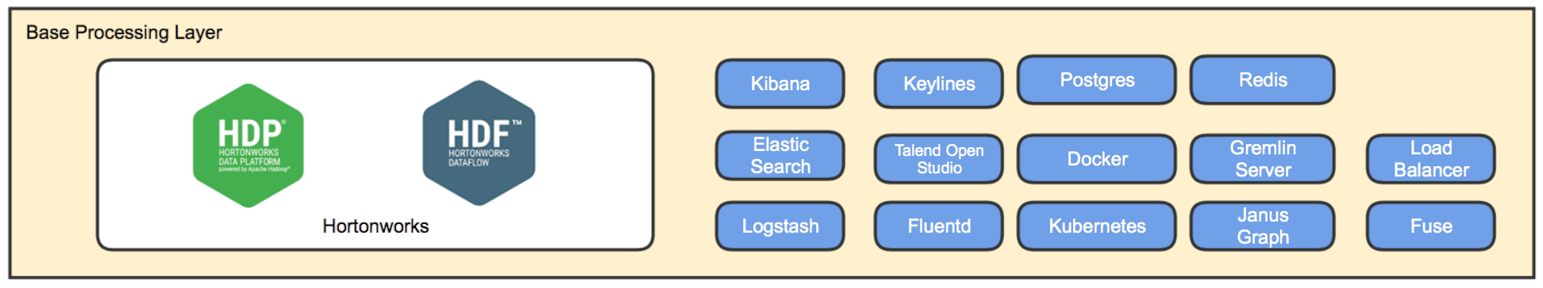

Reflex Building Blocks
Security
App1
Dev Ops
App2
AppN
Ingestion Plugins
Data Processing Plugins
Analytics Plugins
User Interface Plugins
Authentication
Parsers
Graph
Rules Engine **
Continuous Integration
Authorization
Feature Primitives
ML Plugins
Components
Continuous Deployment**
Adaptors
Search
Source/
Sink
Encryption **
Test Automation
Key Management **
Analytics Engine **
User Interface Frameworks
OAM
Ingestion Frameworks
Data Processing Frameworks
Ingestion Service
Data Mgmt Service **
IB Mgmt
Feature Engineering
Model Management
Model Selection
UI Toolkit
Audit Logs
Provisioner
Collector
Interactive Execution
CDAP+
Model Deployment
ML Automation
Superset+ **
** Currently under development

Slide 13
Ingestion
Ingestion Framework selection may be based on:
Connectors
Parsers
UI Support
Pull/Push Model
Data formats
Data provenance capabilities
Transformation/Processing capabilities
Batch/Realtime
No single framework handles all requirements efficiently.
So, Reflex offers versatile ingestion service to simplify data ingestion by encapsulating the complexity around multiple frameworks and use cases.

Slide 14
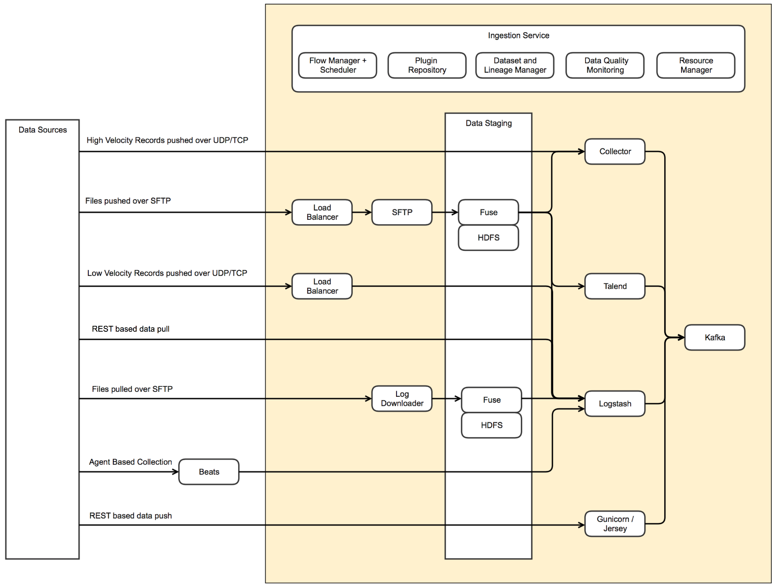


Ingestion Service
Extend reach to data sources:
Optimized collection of high velocity data with low hardware footprint
No single ingestion framework is best-fit for all types of data. Reflex ingestion service hides the variations from user
Never lose data
Pre-formed data ingestion pipelines designed for data resiliency
Data staging to prevent backpressure on source
Gatekeeping of incoming data quality:
Data Quality Monitoring through row-level statistics and alerts
Normalization of data from various data sources
Kafka
Kafka
Kafka

Slide 15
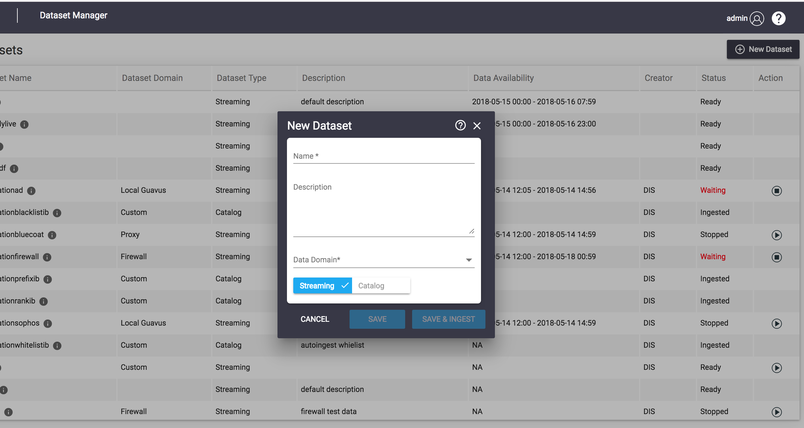
Dataset Manager App
DMA provides the versatile ingestion capabilities
DMA benefits:
Multiple format data ingestion
Varied Data Domain supported
Integrated with multiple data ingestion framework
Support both streaming and catalog data ingestion
Advance statistics enabled
Notes:
Developers also have the flexibility to write their MR, Spark jobs outside CDAP if its really needed. But we recommend to use CDAP for all data processing needs.

Slide 16
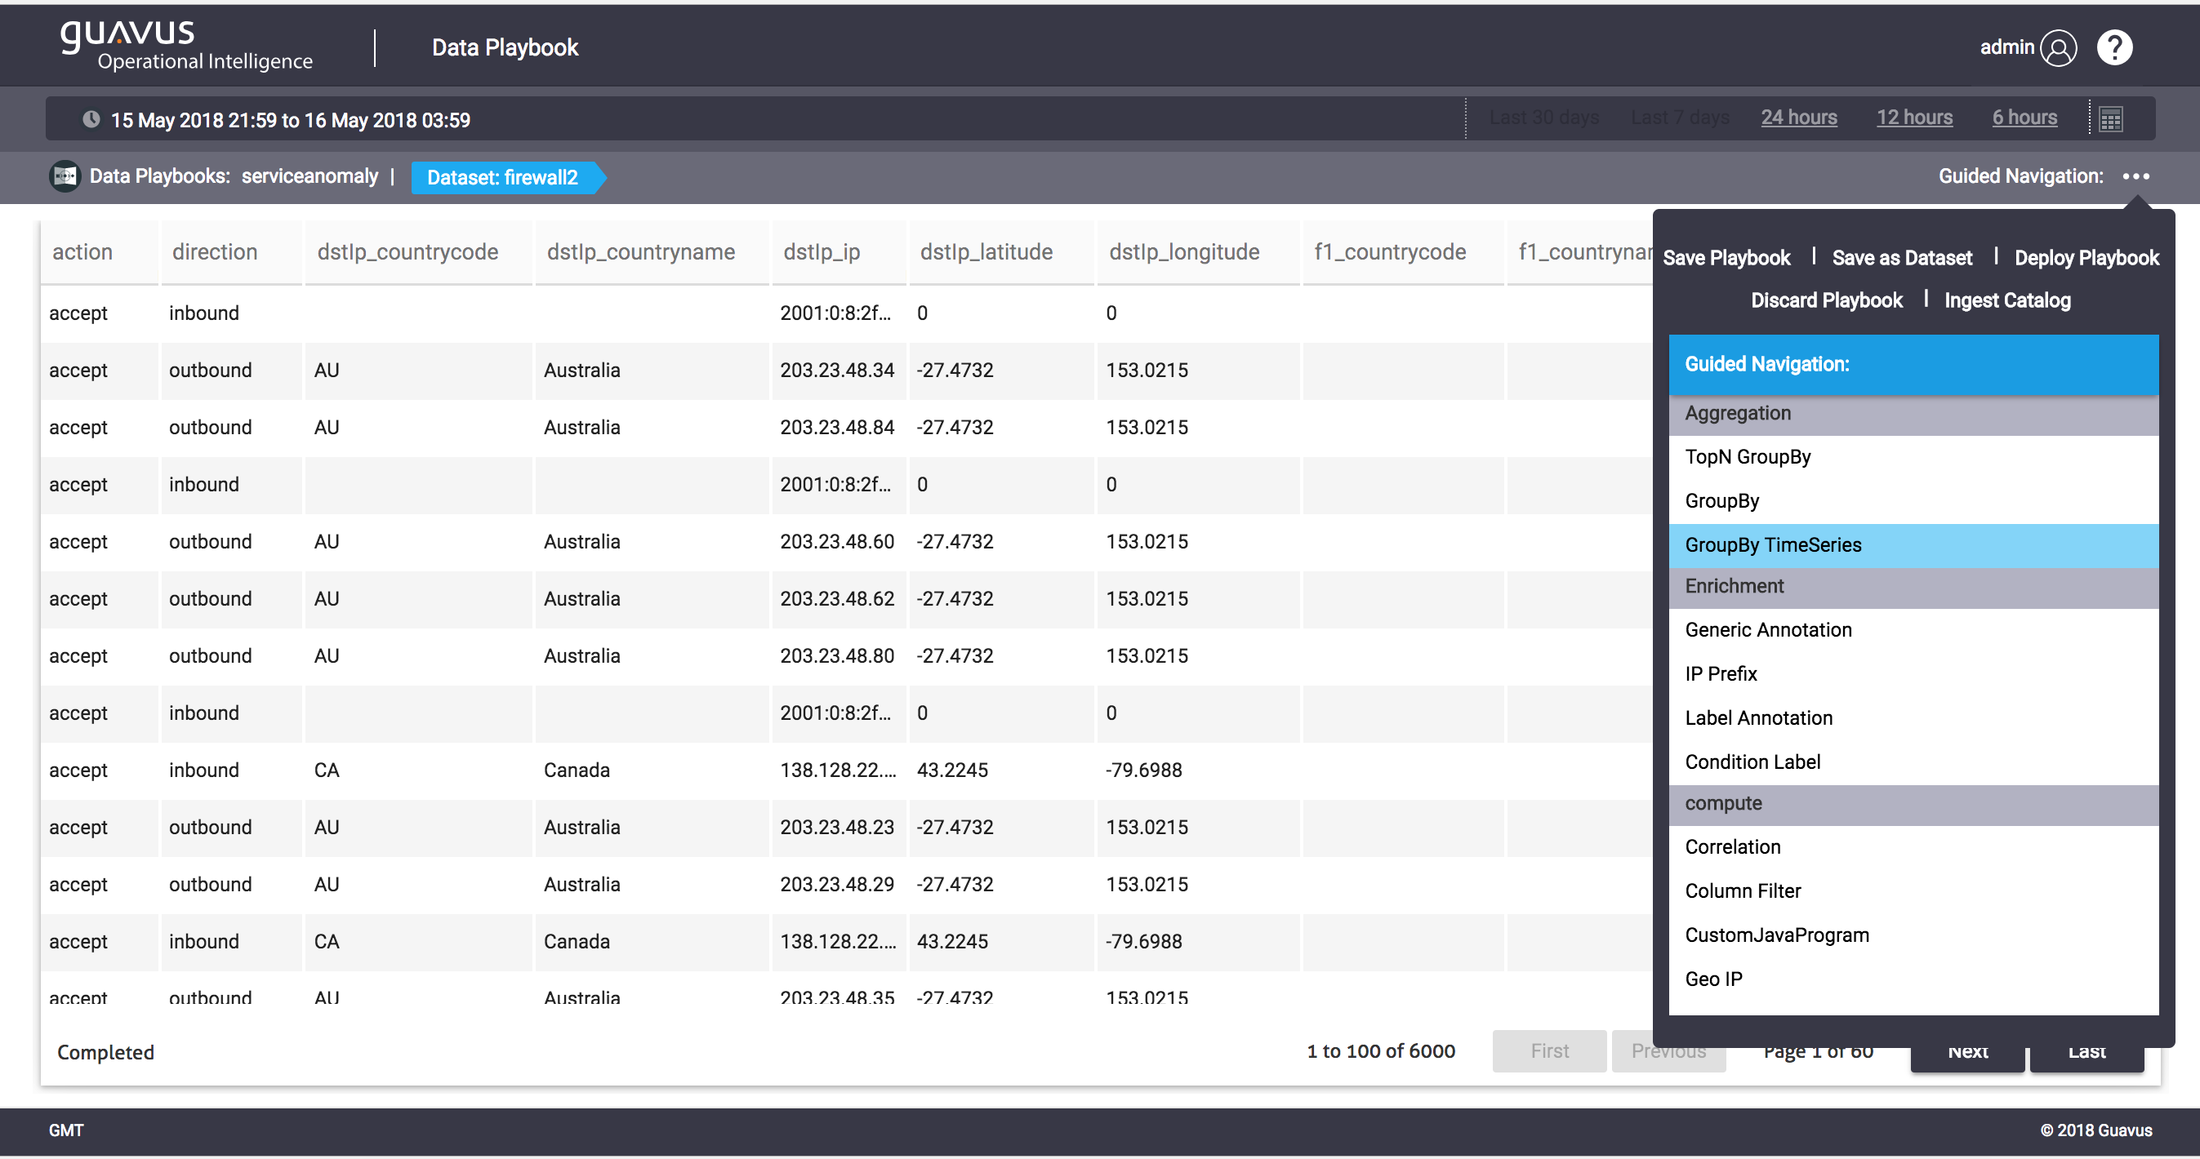
Data Playbook App
DPA provides the advance data exploration capabilities
DPA benefits:
Interactive Data Exploration
Interactive Data Visualization
Workflow building capability
Enabled with Advance Analytics
Accelerators
Notes:
Developers also have the flexibility to write their MR, Spark jobs outside CDAP if its really needed. But we recommend to use CDAP for all data processing needs.

Slide 17
Data Processing: Enrichment and Curation
Data Processing selection may be based on:
Batch/Streaming
Skill set (Java/Scala, MR/Spark Paradigm, MR/Spark API)
It is hard to build and deploy data processing pipelines.
So, Reflex
Simplifies data processing
Can use Mapreduce, Spark or Spark Streaming
UI for stitching pipelines

Slide 18
Data Processing: Analytics
Tools selection may be based on:
Data Exploration and Wrangling capabilities
Feature Engineering
Model Training
Model Management/Deploy
Notebook support
So, Reflex Integrates CDAP, Analytics modules/plugins, Model Management framework and Zeppelin.

Slide 19
Data Storage
Data storage choices may be based on:
Distributed File System
Columnar Store
Key-value Store
In-memory store
Graph store
Full text search store
RDBMS
No single storage is suitable to all kind of use cases.
So, Reflex integrates ElasticSearch, Redis, JanusGraph and Postgres.

Slide 20
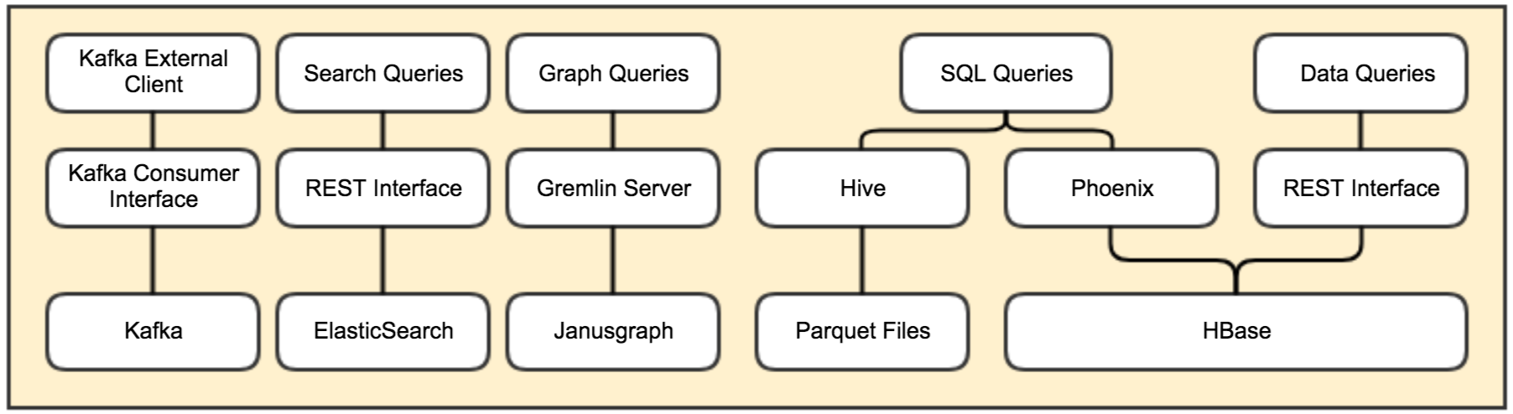
Data Access

Slide 21
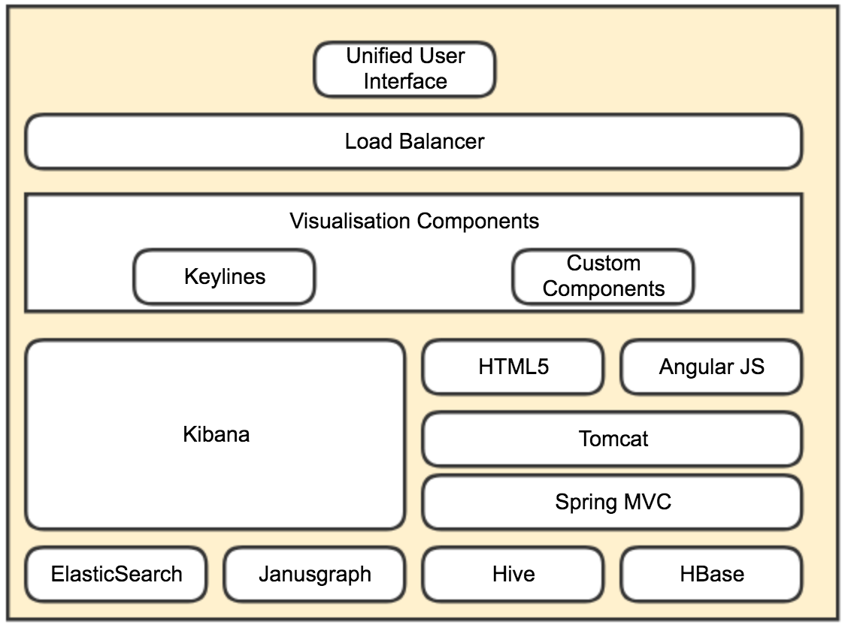

Data Consumption

Slide 22
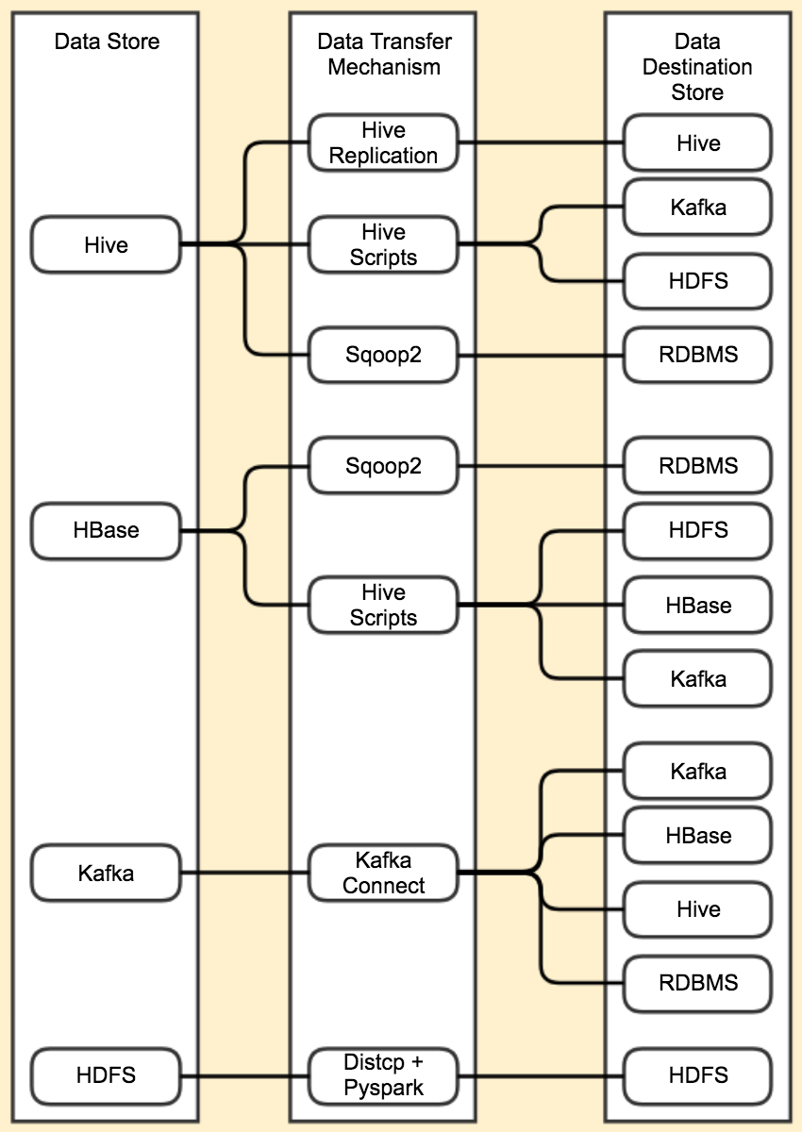
Data Export

Slide 23
Reflex Building Blocks: Revisit
Security
App1
Dev Ops
App2
AppN
Ingestion Plugins
Data Processing Plugins
Analytics Plugins
User Interface Plugins
Authentication
Parsers
Graph
Rules Engine **
Continuous Integration
Authorization
Feature Primitives
ML Plugins
Components
Continuous Deployment**
Adaptors
Search
Source/
Sink
Encryption **
Test Automation
Key Management **
Analytics Engine **
User Interface Frameworks
OAM
Ingestion Frameworks
Data Processing Frameworks
Ingestion Service
Data Mgmt Service **
IB Mgmt
Feature Engineering
Model Management
Model Selection
UI Toolkit
Audit Logs
Provisioner
Collector
Interactive Execution
CDAP+
Model Deployment
ML Automation
Superset+ **
** Currently under development

Slide 24
Reflex (1)
Makes it easy to build end-to-end big data applications.
Multiple data ingestion tool choices (per use case)
Simplifies data processing
Analytics
Notebook support
Model Management Framework
Model Deployment
Extends data model portfolio with:
For search use cases (ES)
For graph use cases (JanusGraph)
For in-memory key-value store (Redis)
Notes:
Components/Tools to build end-to-end big data applications
Organizations have invested in build data lakes but they are not able to optimally leverage them because of lack of tools/applications/frameworks that allow them to build applications on top of the data lake. RAF allows you to leverage your data warehouse/data lakes by providing you end-to-end big data application development tools/components/integrations.

Slide 25
Reflex (2)
7. Data Bus (Kafka) based processing
8. UI
UI Toolkit(HTML5/Angular)
SuperSet+/Kibana for presentation layer
9. Due diligence before tool/framework integration
10. Allows you flexibility to integrate specific tools with Kubernetes/Docker.

Slide 26
HDP/HDF Components

Slide 27
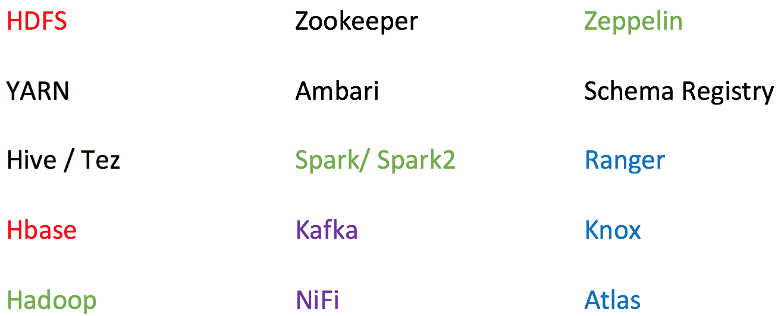
Hortonworks Stack
Base Tech Stack used in Reflex is Hortonworks HDP/HDF.
Open source policy
Ambari support
Data governance
Security through Knox and Ranger

Slide 28
Resource Management

Slide 29
Resource Management
YARN to manage resources for all Spark, Spark Streaming applications.
Resources supported by YARN are CPU and Memory
Kubernetes to manage Containers and their resources.
Resources supported by Kubernetes are CPU, Memory

Slide 30
YARN
Central to Hadoop Clusters.
Multi-tenancy
Cluster Utilization
Scalability
Notes:
https://2xbbhjxc6wk3v21p62t8n4d4-wpengine.netdna-ssl.com/wp-content/uploads/2014/10/YARN-with-Slider.png

Slide 31
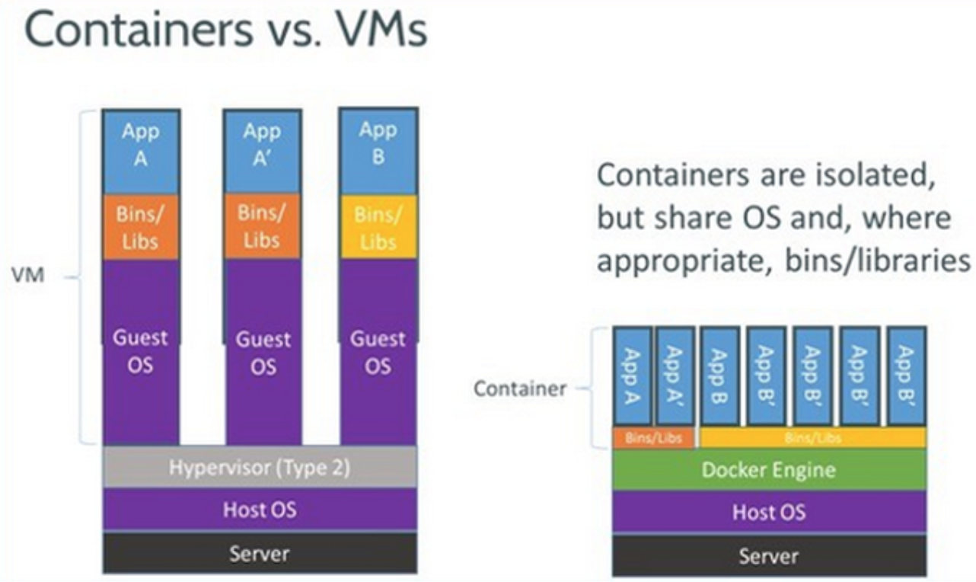
Docker
Allows users to package an application with all of its dependencies into a standardized unit.
Lightweight
Isolation
Simplicity
DevOps
Micro-services

Slide 32
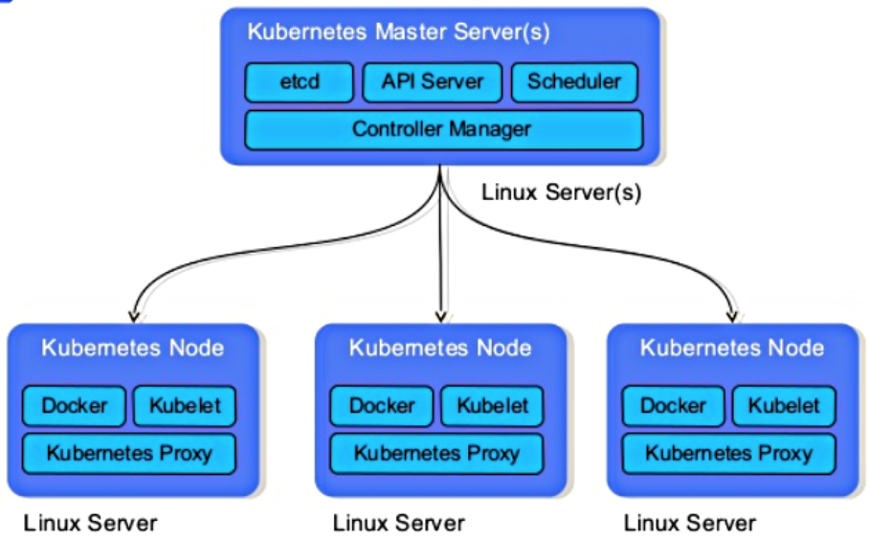
Kubernetes
Provides a container-centric management environment.
It orchestrates computing, networking, and storage infrastructure on behalf of user workloads.
Features:
Intelligent Scheduling
Self-healing
Horizontal scaling
Storage orchestration
Load balancing
Automated rollouts and rollbacks
Batch Execution

Slide 33
Ingestion/Collection

Slide 34
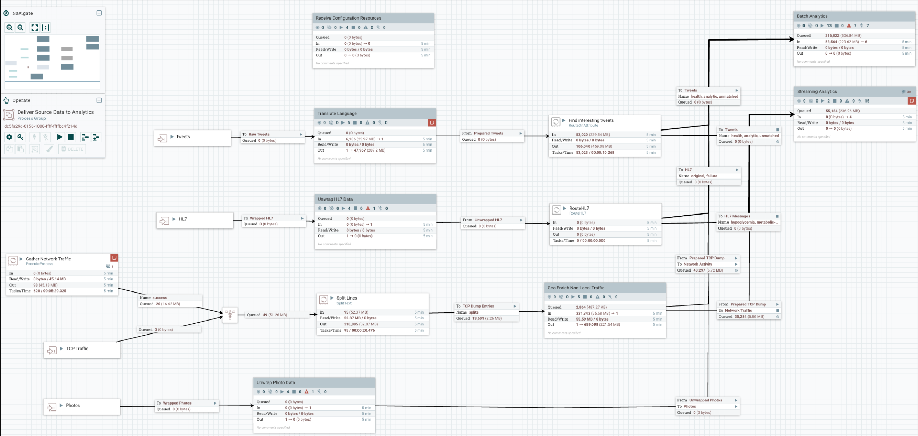
NiFi
Apache NiFi supports powerful and scalable directed graphs of data routing, transformation, and system mediation logic. Some of the high-level capabilities and objectives of Apache NiFi include:
Web-based user interface
Highly configurable
Data Provenance
Designed for extension
Secure
Notes:
Web UI for designing pipelines and offer data provenance, performance around transformation is limiting and no complex processing like aggregations etc, allows a developer to change pipelines dynamically.

Slide 35
Talend
Open Source
Eclipse based developer tooling to design jobs
Orchestrate dataflows and integrations
Ingestion, loading and unloading of data into data lake
Notes:
talend has simillar capabilities as nifi but only supports, desktop based tool, u cant change pipelines on runtime. At least with the open source version.

Slide 36
LogStash
Logstash is a light-weight, open-source, server-side data processing pipeline that allows you to collect data from a wide variety of sources, transform it on the fly, and send it to your desired destination.
It is most often used as a data pipeline for ElasticSearch.
Easily Load Unstructured Data
Pre-built Filters
Flexible Plugin Architecture
Notes:
logstash beats everybody for semi-structured data, and list of available pluings are huge, best suited for log type data.

Slide 37
Guavus Collector
Best performance per core
GenericAdaptor
Batch and Streaming
HDFS
Kafka
Notes:
Best per core processing capacity, works with huge volumes of structured data.
These frameworks are not mutually exclusive. You might use multiple of them in an application.

Slide 38
Ingestion
These tools/frameworks are not mutually exclusive.
You may choose to run multiple for an application.
The choice will depend on use case.

Slide 39
Data Bus

Slide 40
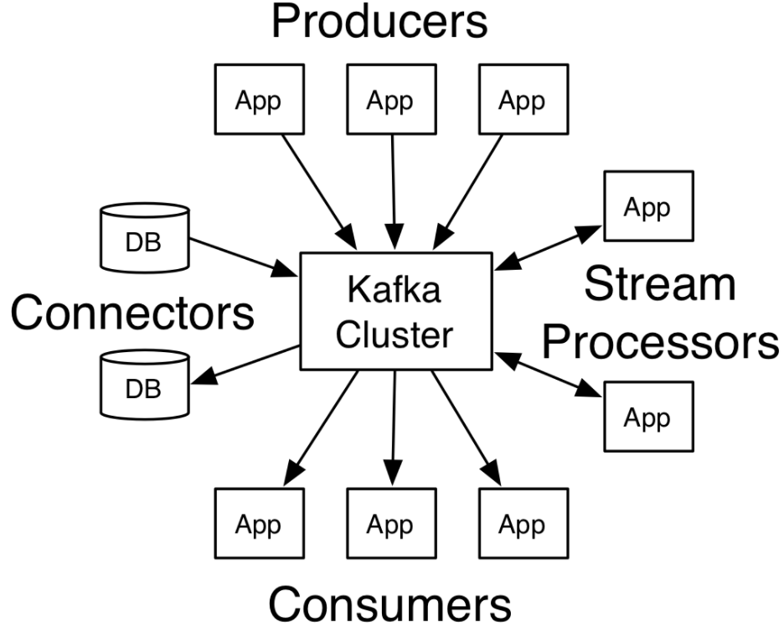
Kafka
Apache Kafka is a distributed streaming platform.
A Streaming platform has key capabilities:
Pub-Sub (allow data democratization)
Fault-tolerance and Durable
Low Latency
Scalable by adding more nodes
Integrates with most big data frameworks

Slide 41
Data Storage

Slide 42
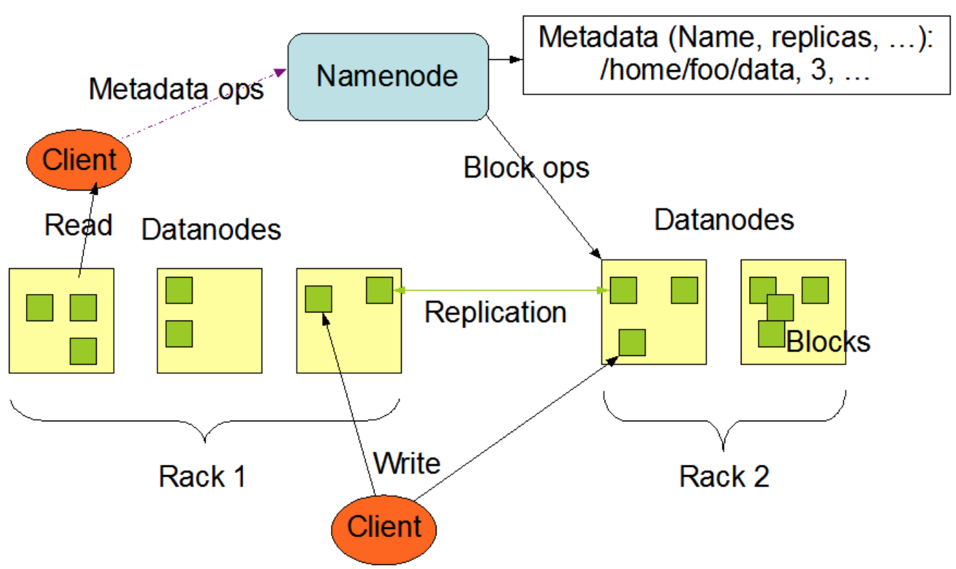
HDFS

Slide 43
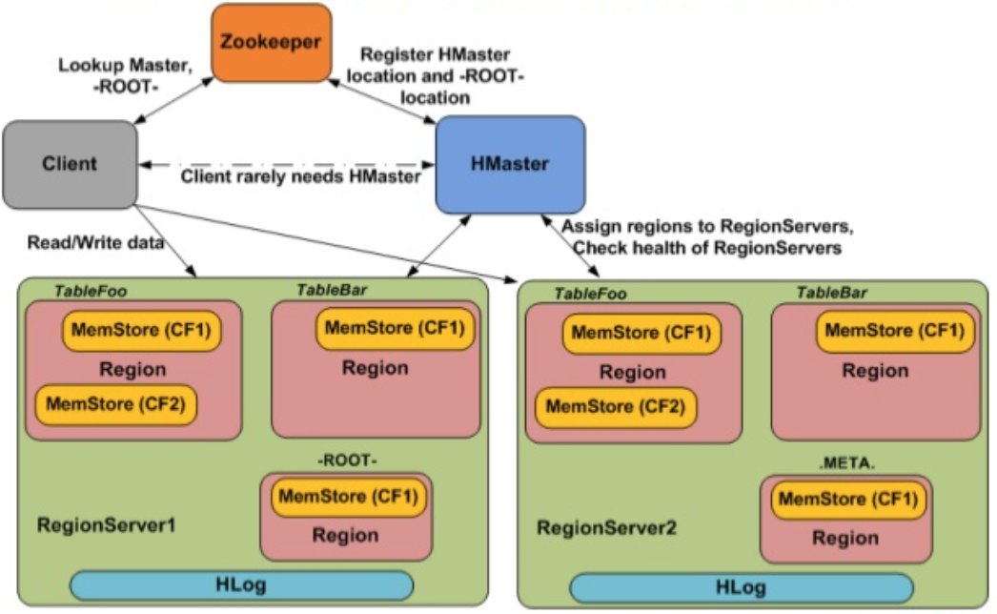
HBase
HBase is the Hadoop database, a distributed, scalable, big data store.
Key features:
Fast random, real-time R/W access
Versioned
Strictly consistent
NoSql
Highly Available
Based on BigTable

Slide 44
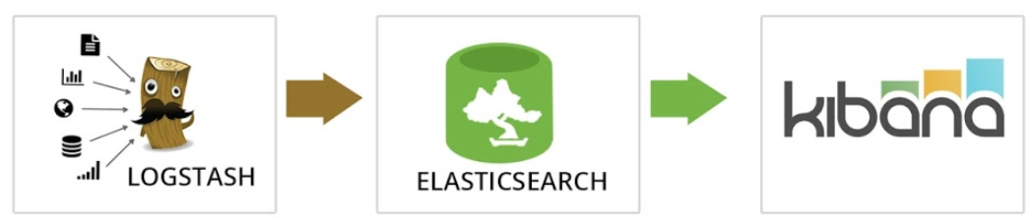
ElasticSearch
Elasticsearch is an open-source, RESTful, distributed search and analytics engine built on Apache Lucene.
When coupled with Kibana, a visualization tool, Elasticsearch can be used to provide near-real time analytics using large volumes of log data.
ES benefits:
Fast
Easy to Use
Complementary tooling
Near real-time index update
Support for many languages

Slide 45
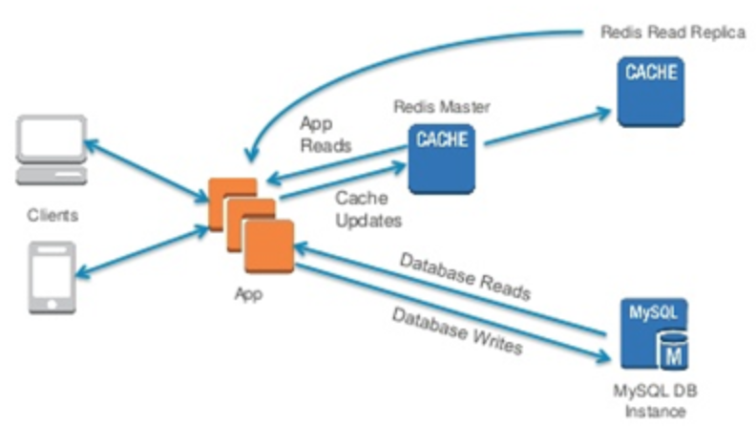
Redis
Redis is an open source, in-memory data structure store, used as a database, cache and message broker (pub-sub).
Support rich data types.
Built-in replication
LRU eviction
Transactions and
On-disk persistence.
Spark Jobs do not manage state across executions. So Redis can be used to manage state in such use cases.

Slide 46
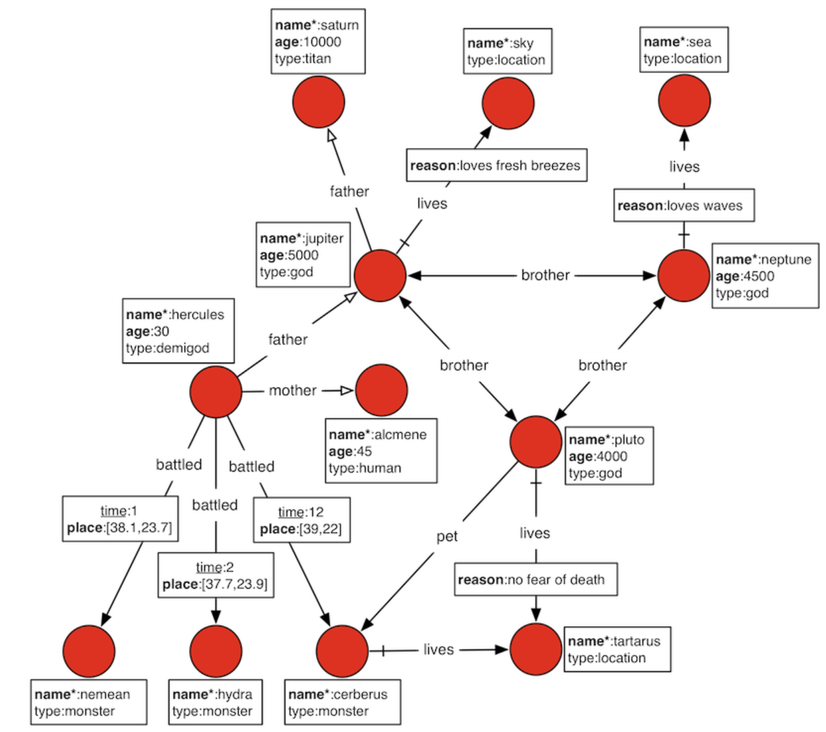
JanusGraph/Gremlin
JanusGraph is a scalable graph database optimized for storing and querying graphs containing hundreds of billions of vertices and edges distributed across a multi-machine cluster.
Gremlin is a graph traversal language.

Slide 47
RAF | Data Model Choices
Choose the right tool for the job.
Data Model | Storage/DB
Distributed File System | HDFS
Columnar | HDFS (Parquet/ORC)
Key-value | HBase
In-Memory Key-Value | Redis
Search | ElasticSearch
Graph | GanusGraph
Relational | Postgres

Slide 48
Processing & Workflow Management

Slide 49
CDAP
CDAP is the unified integration platform for big data.
CDAP benefits:
High level and easy to Use
Faster time to market
Build once and run anywhere
Enterprise ready
Wrangling
Model training
Notes:
Developers also have the flexibility to write their MR, Spark jobs outside CDAP if its really needed. But we recommend to use CDAP for all data processing needs.

Slide 50
Zeppelin
Web-based notebook that enables interactive data analytics.
Model Training

Slide 51
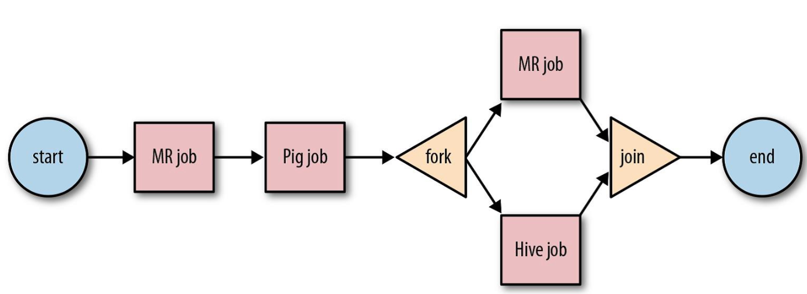
Oozie
Oozie is a workflow scheduler system to manage Hadoop jobs
Oozie workflow jobs are DAG of actions.
Can be scheduled to be triggered by time or data availability.
Supports out of box
MR
Pig/Hive
Scoop
Distcp
Shell Script etc…
Notes:
You may choose to hide this slide.

Slide 52
Provisioning in RAF

Slide 53
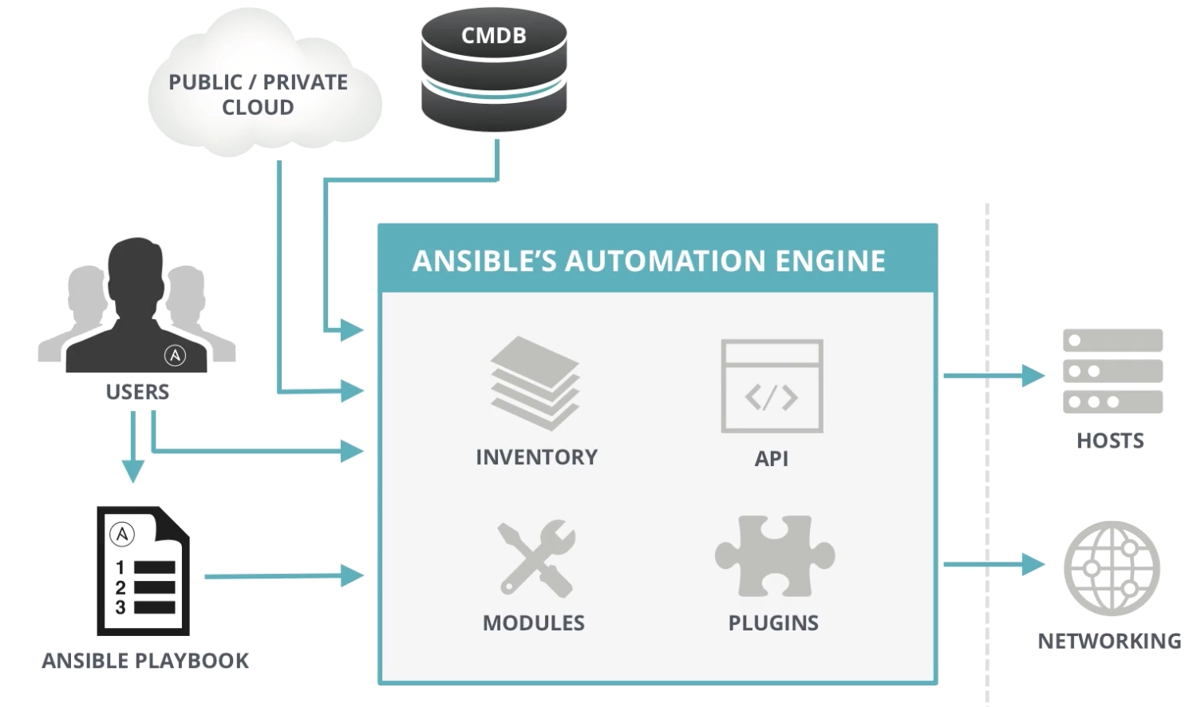
Ansible | Application Deployment and Config Management
Automates software provisioning, configuration management, and application deployment.
No Agents; connects via SSH
Plugins support
Dry run
…

Slide 54
Ambari (Provisioning and Management of HWX stack)
Simplifies provisioning, managing, and monitoring Apache Hadoop clusters.
Ambari provides an intuitive, easy-to-use Hadoop management web UI backed by its RESTful APIs.
Integrates most Hadoop ecosystem
Highly extensible and customizable
Centralized Security
Visibility into cluster health

Slide 55
Operations, Administration and Management

Slide 56
Reflex OAM
Installation - Ambari or Ansible
Log Management - Fluentd + ES + Kibana
Management and Basic Operations Monitoring - Ambari, Kubernetes Dashboard/CLI
Detailed Monitoring (Debugging Metrics) - Grafana

Slide 57
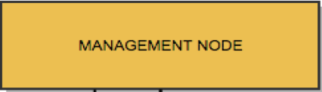
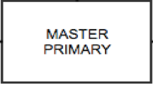
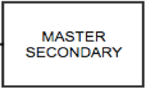
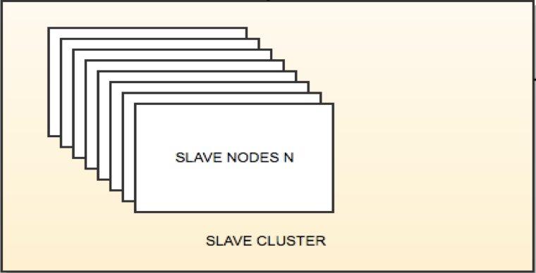
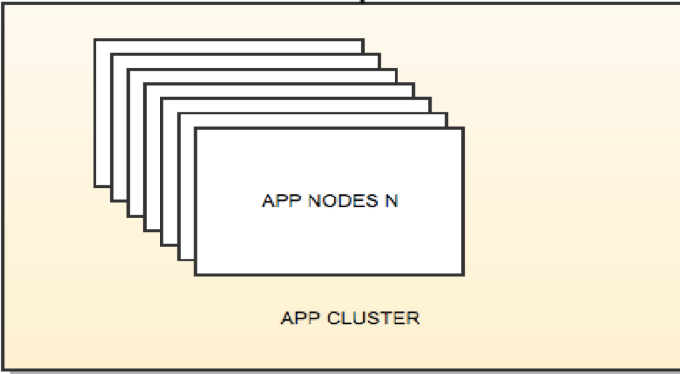
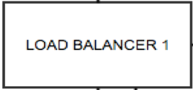
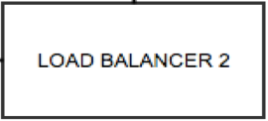
REFLEX | Physical Layout

Slide 58
Summary

